Slide 1
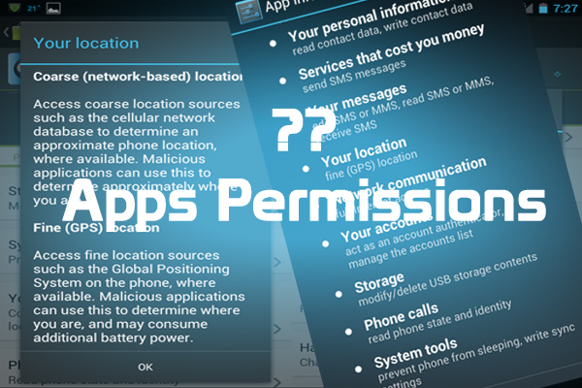
Acute Analysis of Over Privileged Android Applications Basundhara Dey and Rishi Wadhwani Department of Computer Science University of Central Florida, April 2015

Slide 2
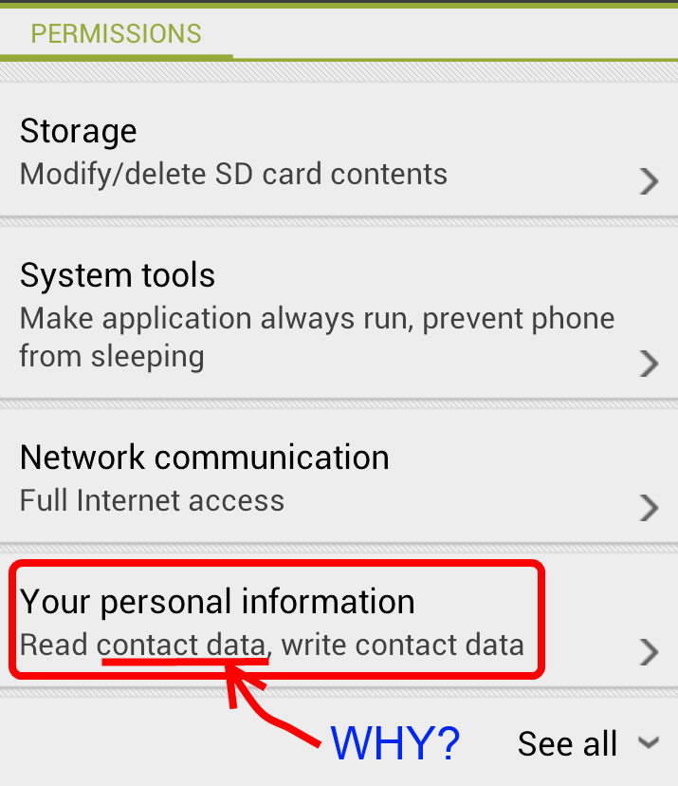
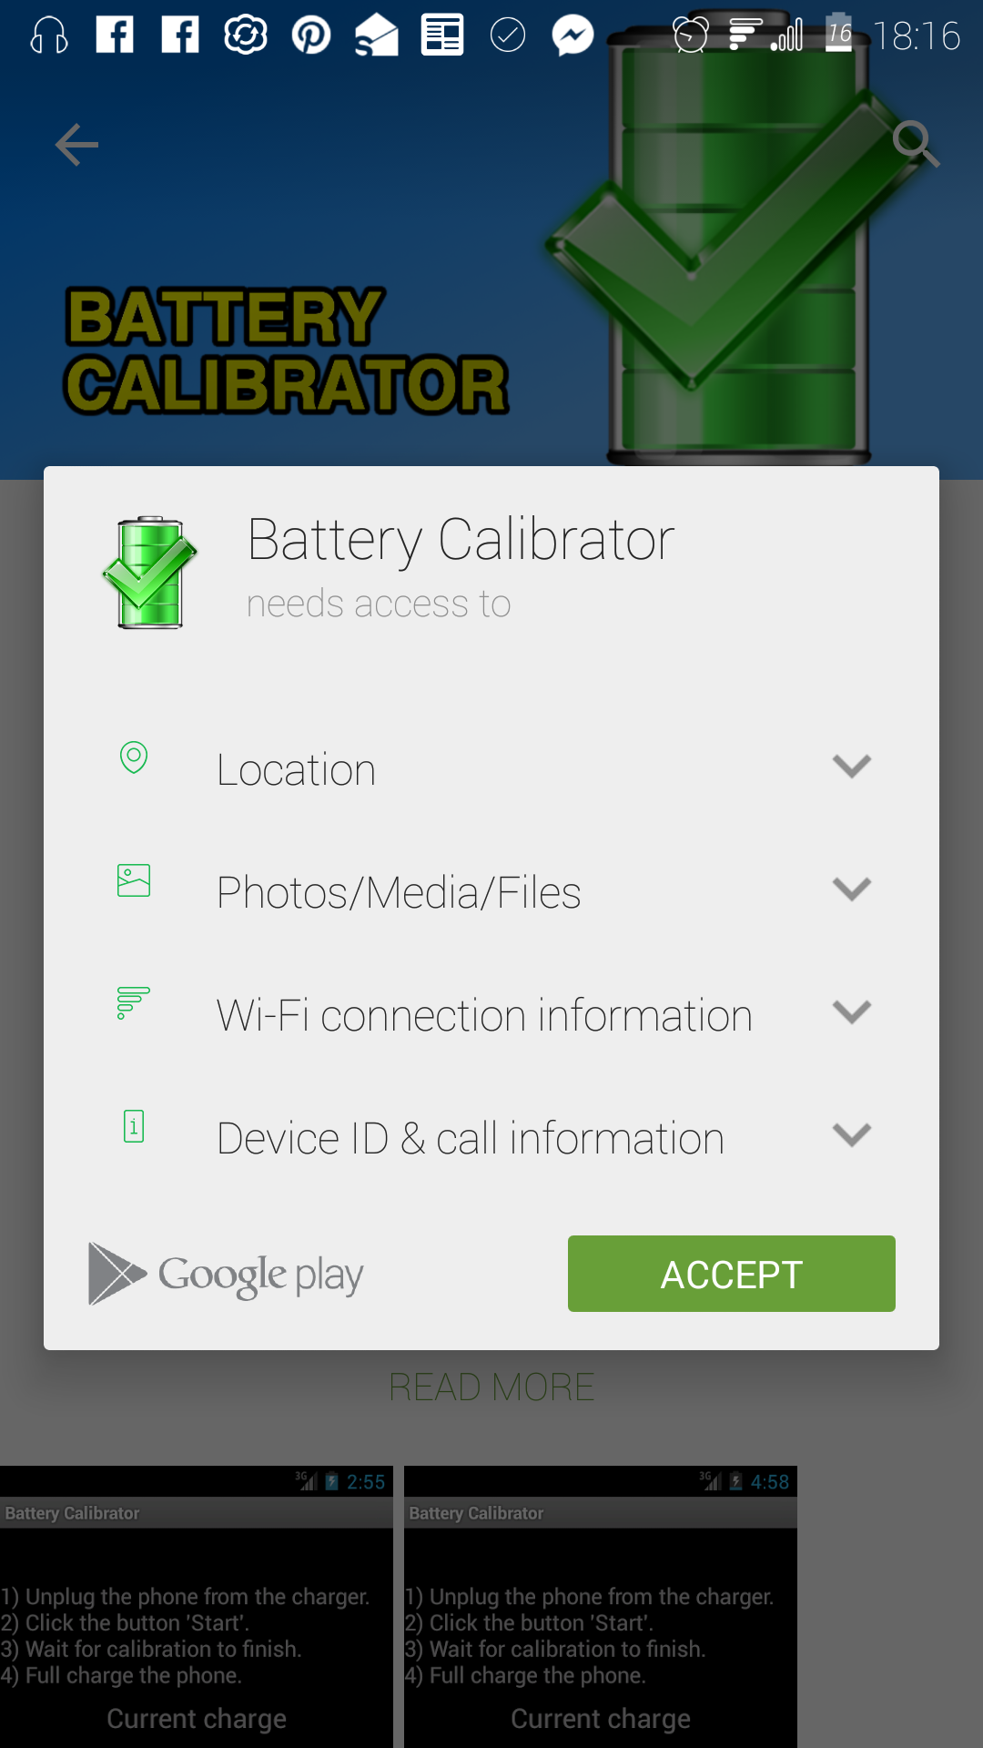
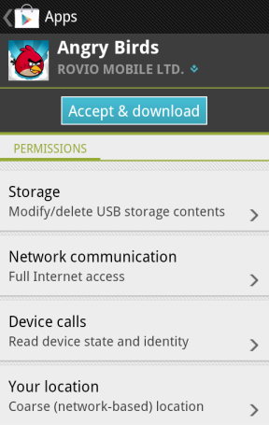
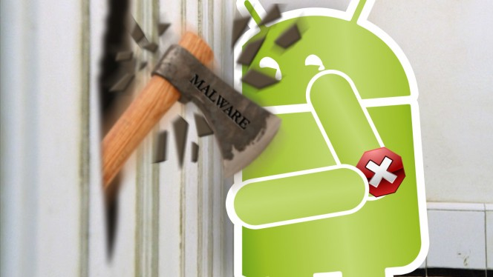

Slide 3
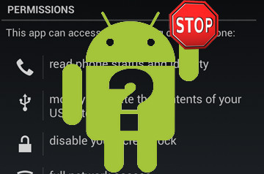
Overview
The fluidity of application markets complicate smart phone security. - the lack of a common definition for security and the volume of applications ensures that some malicious, questionable and vulnerable applications will find their way.
Primary Contributions in the paper. - developing a real time app using Android Studio - In depth understanding of Android permission system
Discussion and Future Work. - showcase real time over privileged app - build a scanner or tool to prevent this malicious function

Slide 4
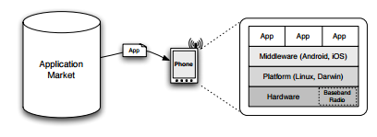
Android Permission System
Apps statically request permissions in the AndroidManifest.xml file
No support for dynamically granting apps permissions at run-time.
The user sees a dialog at install time, and can choose to cancel installing the app based on the requested permissions.
Relies on the user’s understanding of the various permissions.

Slide 5
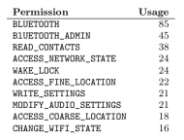
Permission Categories
Permissions are organized into 3 categories:
Normal - API calls that could annoy but not harm the user, e.g. SET WALLPAPER
Dangerous - API calls that could be used to charge the user money or leak private information such as READ CONTACTS
Signature / System - ability to delete application packages, control backup. Only allowed by apps signed by the manufacturer.

Slide 6
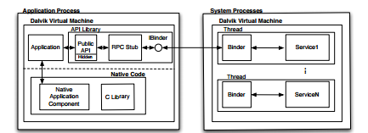
Permission System Layout

Slide 7

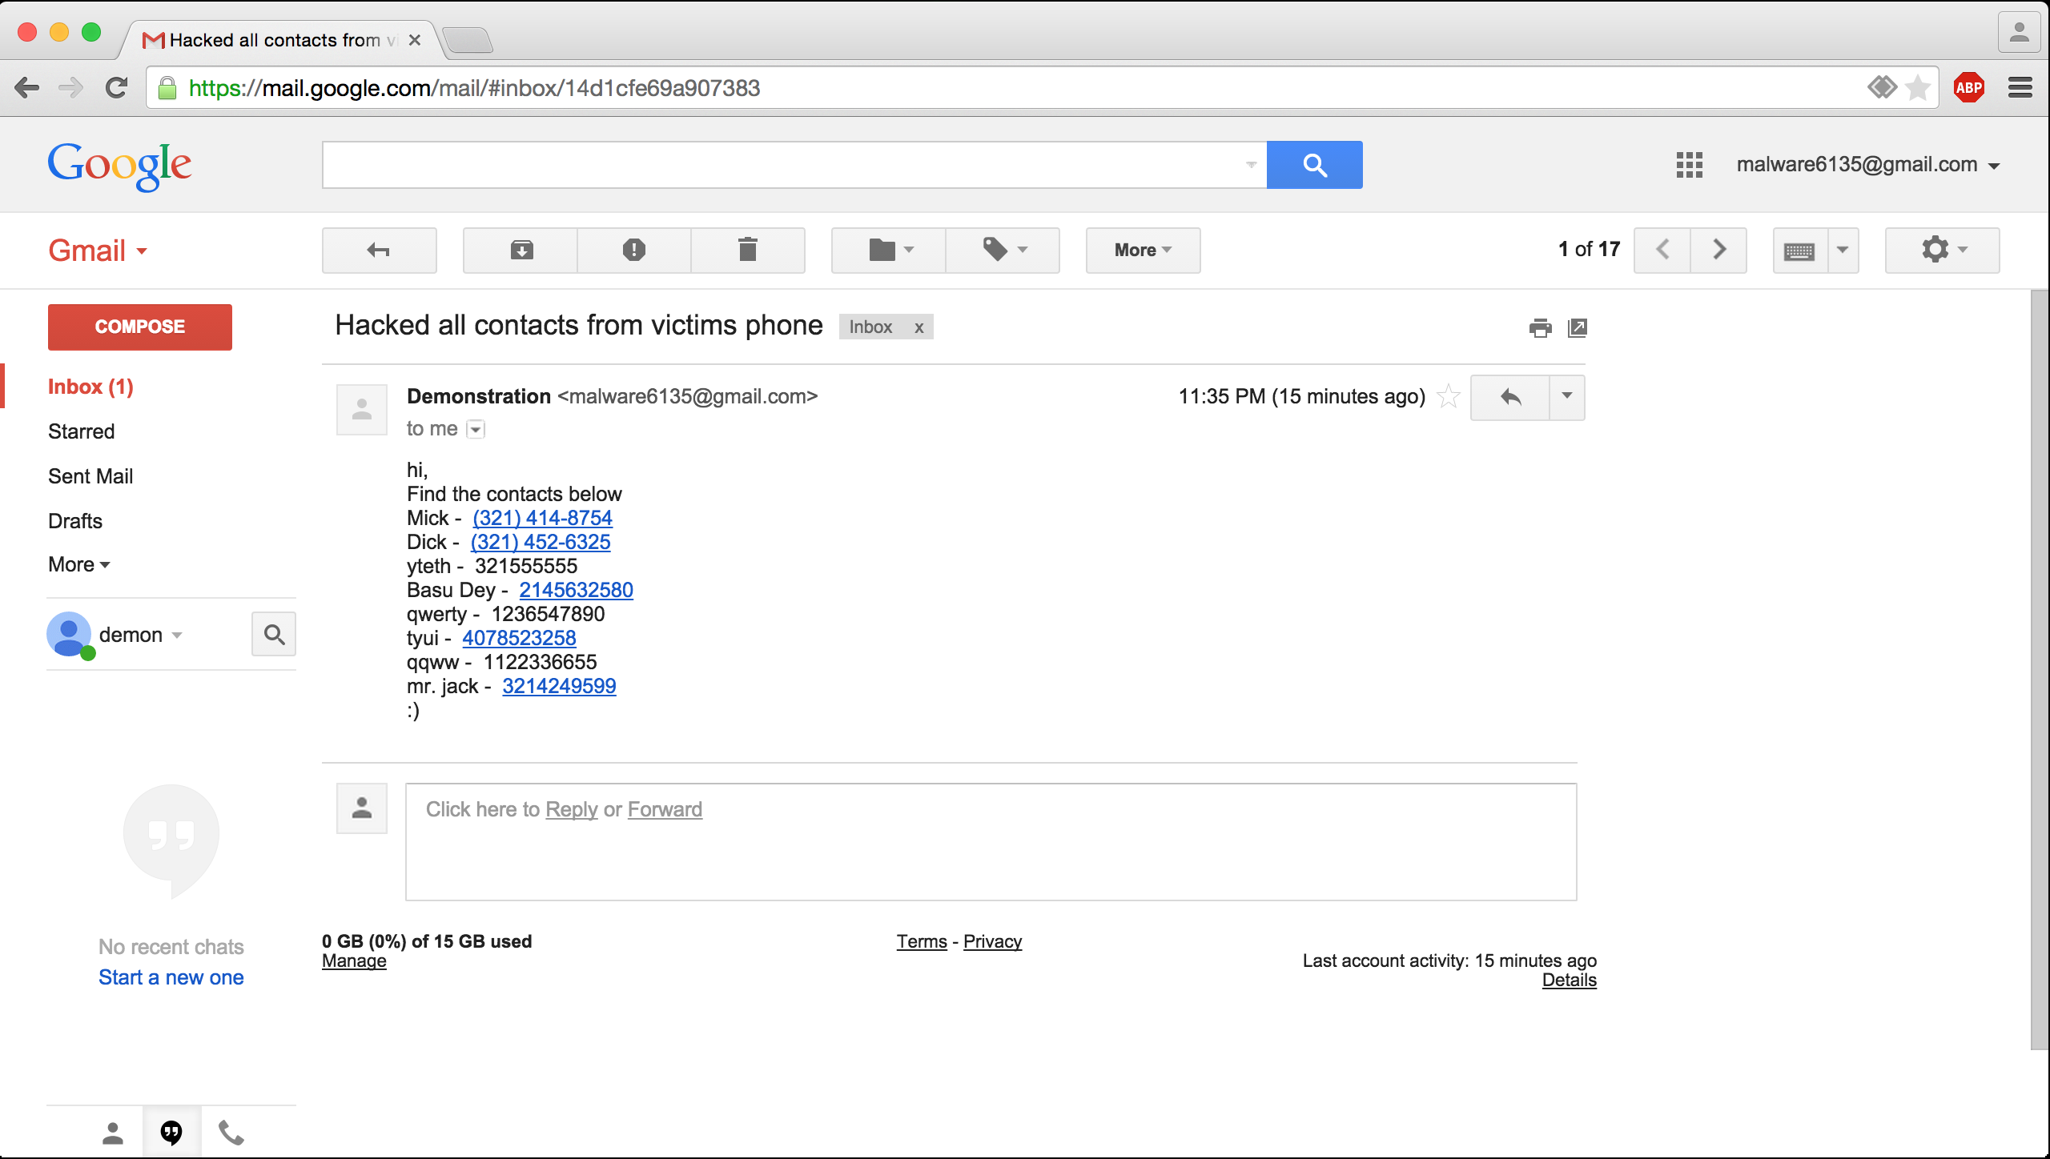
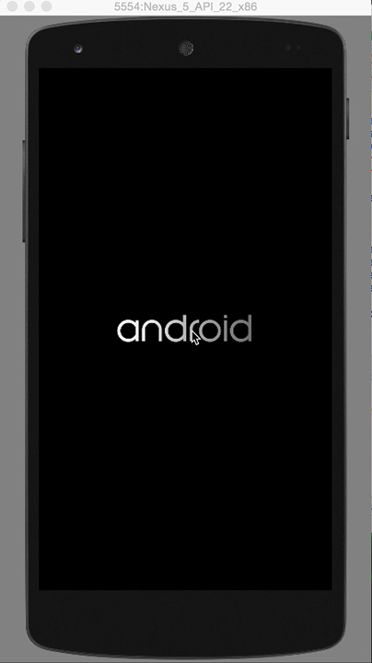
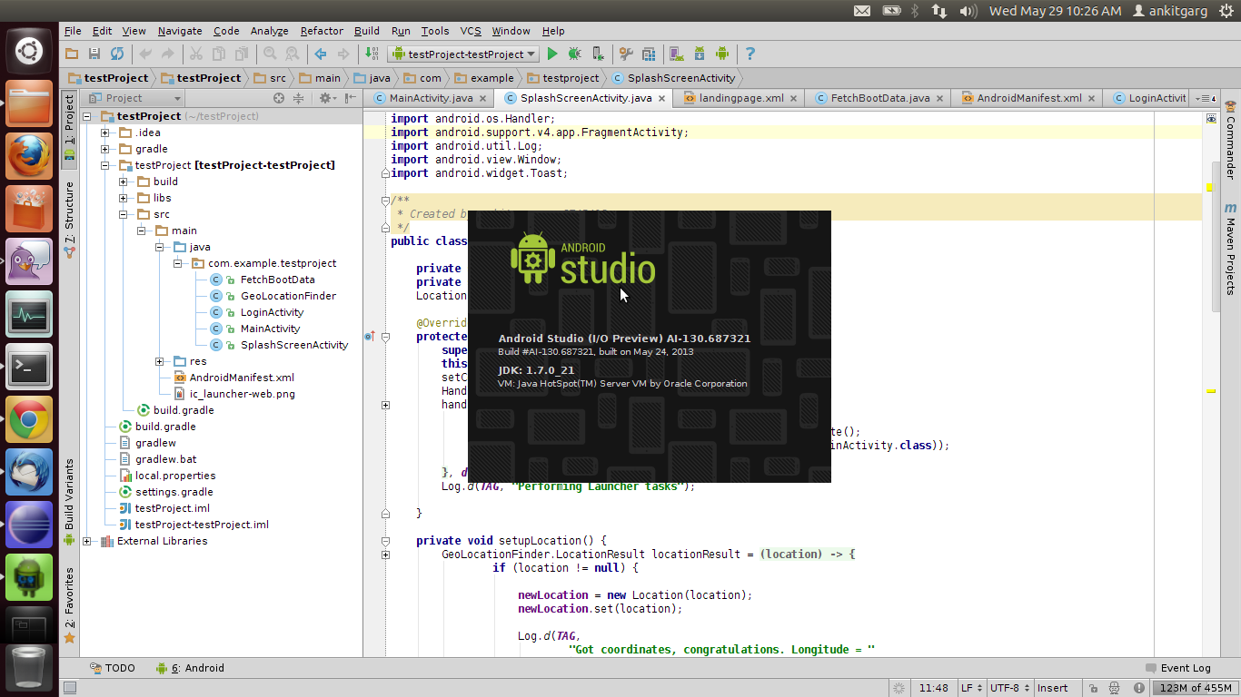
Virtual Demo
Click to play demo video

Slide 8

Related Work
Contribution. - developing a real time app using Android Studio - in depth understanding of Android permission system.
Weakness. - no exact cite that provide any optimum or perfectly successful solution - duplication of permission, hard to solve.
Possible Improvement. - build an app/tool to scan the malicious permission - improve the app with more real time features and more possible vulnerabilities

Slide 9
